Slide 1



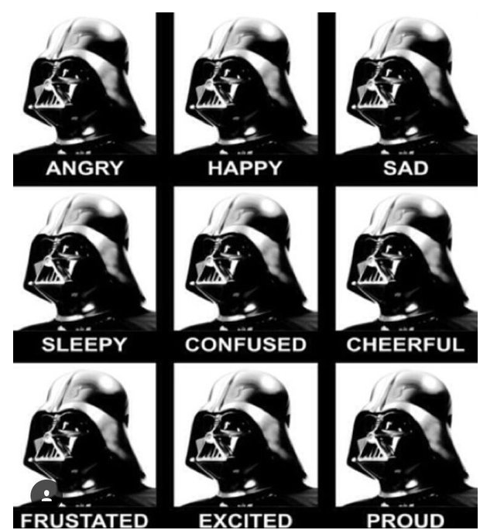
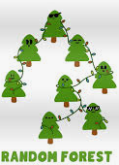



HTML
CSS
JAVASCRIPT
LEAFLET
YES!
Ranked features
Key data stats
Can a trail’s popularity be predicted by its features?

